Slide 1
Basic MATLAB Programming
Chul Min Yeum
Assistant Professor
Civil and Environmental Engineering
University of Waterloo, Canada
AE121: Computational Method
Last updated: 2019-04-12

Slide 2
Variables and Assignments
To store a value, use a variable
one way to put a value in a variable is with an assignment statement
general form:
variable = expression
The order is important
variable name on the left
the assignment operator “=” (Note: this does NOT mean equality)
expression on the right

Slide 3
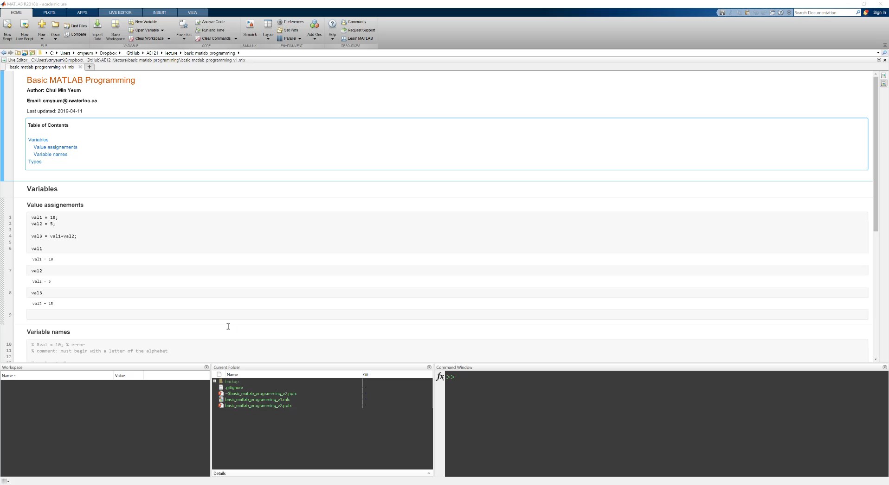
Variables and Assignments

Slide 4
Modifying Variables
Initialize a variable (put its first value in it)
mynum = 5;
Change a variable (e.g. by adding 3 to it)
mynum = mynum + 3;
Increment by one
mynum = mynum + 1;
Decrement by two
mynum = mynum – 2;
NOTE: after this sequence, mynum would have the value 7 (5+3+1-2)

Slide 5
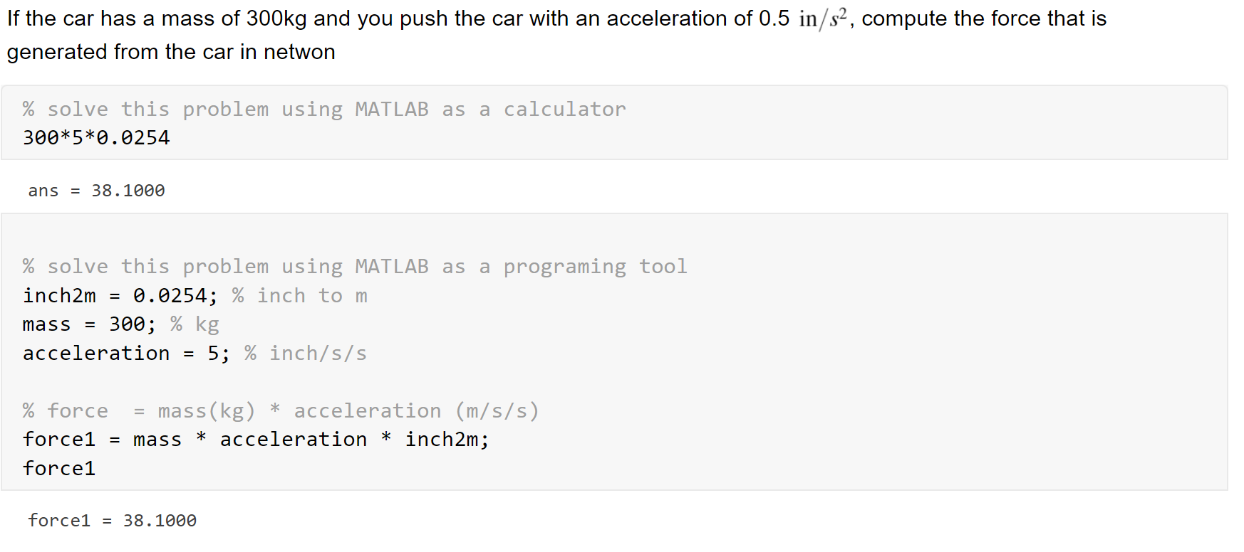
Example: Arithmetic Operation in MATLAB
Which approach is better?

Slide 6
Variable names
Names must begin with a letter of the alphabet
After that names can contain letters, digits, and the underscore character(_)
MATLAB is case-sensitive
Names should be mnemonic (they should make sense!)
The commands who and whos will show variables (Recommend: You would need to use a workspace browser rather than type these command)
To delete variables: clearvars
clear clears out variables and also functions

Slide 7
Example: Variable Names

Slide 8
Types
Every expression and variable has an associated type, or class
Real numbers: single, double
Integer types: numbers in the names are the number of bits used to store a value of that type
Signed integers: int8, int16, int32, int64
Unsigned integers: uint8, uint16, uint32, uint64
Single characters and character vectors: char
Strings of characters: string
True/false: logical
The default type for numbers is double

Slide 9
Range and Type Size
Range of integer types found with intmin/intmax
e.g. intmin(‘int8’) is -128, intmax(‘int8’) is 127
Converting from one type to another, using any of the type names as a function, is called casting or type casting, e.g:
CODE

Slide 10
Expressions
Expressions can contain values, variables that have already been created, operators, built-in functions, and parentheses
Operators include:
+ addition
* multiplication
/ division (divided by e.g. 10/5 is 2)
\ division (divided into e.g. 5\10 is 2)
^ exponentiation (e.g. 5^2 is 25)
Scientific or exponential notation: use e for exponent of 10 raised to a power
e.g. 3e5 means 3 * 10^5 (e becomes a operators).
Not recommend to use e because it is confused with exponential (exp) in your code.

Slide 11
Constants
In programming, variables are used for values that could change, or are not known in advance
Constants are used when the value is known and cannot change
Examples in MATLAB (these are actually functions that return constant values)
pi 3.14159….
i, j
inf infinity
NaN stands for “not a number”; e.g. the result of 0/0

Slide 12
Operator Precedence
Some operators have precedence over others
Precedence list (highest to lowest) so far:
( ) parentheses
^ exponentiation
- negation
*, /, \ all multiplication and division
+, - addition and subtraction
Nested parentheses: expressions in inner parentheses are evaluated first
CODE

Slide 13
Using Functions: Terminology
To use a function, you call it
To call a function, give its name followed by the argument(s) that are passed to it in parentheses
Many functions calculate values and return the results
For example, to find the absolute value of -4
>> abs(-4)
ans =
4
The name of the function is “abs”
One argument, -4, is passed to the abs function
The abs function finds the absolute value of -4 and returns the result, 4

Slide 14
Random Numbers
Several built-in functions generate random (actually, pseudo-random) numbers
Random number functions, or random number generators, start with a number called the seed; this is either a predetermined value or from the clock
By default MATLAB uses a predetermined value so it will always be the same
To set the seed using the built-in clock:
rng(‘shuffle’)

Slide 15
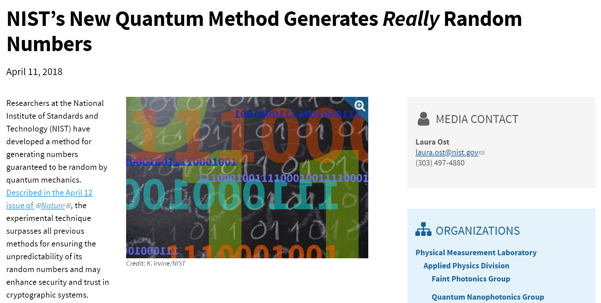
(Off-Topic) Quantum Random Number
https://www.nist.gov/news-events/news/2018/04/nists-new-quantum-method-generates-really-random-numbers

Slide 16
Random Real Numbers
The function rand generates uniformly distributed random real numbers in the open interval (0,1)
Calling it with no arguments returns one random real number
To generate a random real number in the open interval (0,N):
rand * N
randn is used to generate normally distributed random real numbers

Slide 17
Characters and Strings
A character is a single character in single quotes
All characters in the computer’s character set are put in an order using a character encoding
In the character encoding sequence, the letters of the alphabet are in order, e.g. ‘a’ comes before ‘b’
Common encoding ASCII has 128 characters, but MATLAB can use a much larger encoding sequence
The character set includes all letters of the alphabet, digits, punctuation marks, space, return, etc.
Character vectors are sequences of characters in single quotes, e.g. ‘hello and how are you?’
Strings are sequences of characters in double quotes, e.g. “ciao bella”

Slide 18
Characters and Encoding
standard ASCII has 128 characters; integer equivalents are 0-127
any number function can convert a character to its integer equivalent
>> numequiv = double('a')
numequiv =
97
the function char converts an integer to the character equivalent (e.g. char(97))
MATLAB uses an encoding that has 65535 characters; the first 128 are equivalent to ASCII

Slide 19
Relational Expressions
The relational operators in MATLAB are:
> greater than
< less than
>= greater than or equals
<= less than or equals
== equality
~= inequality
The resulting type is logical 1 for true or 0 for false
The logical operators are:
|| or for scalars
&& and for scalars
~ not
Also, xor function which returns logical true if only one of the arguments is true

Slide 20
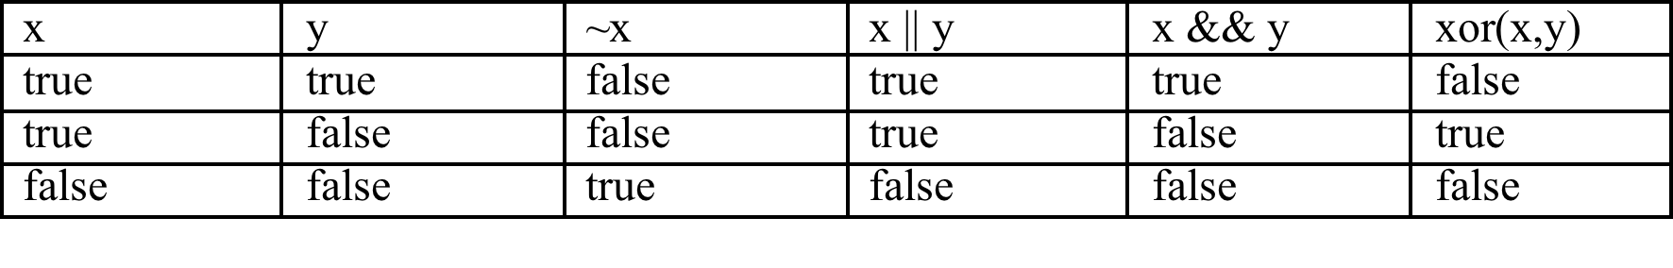
Truth Table
A truth table shows how the results from the logical operators for all combinations
Note that the logical operators are commutative (.e.g., x|| y is equivalent to y || x)

Slide 21
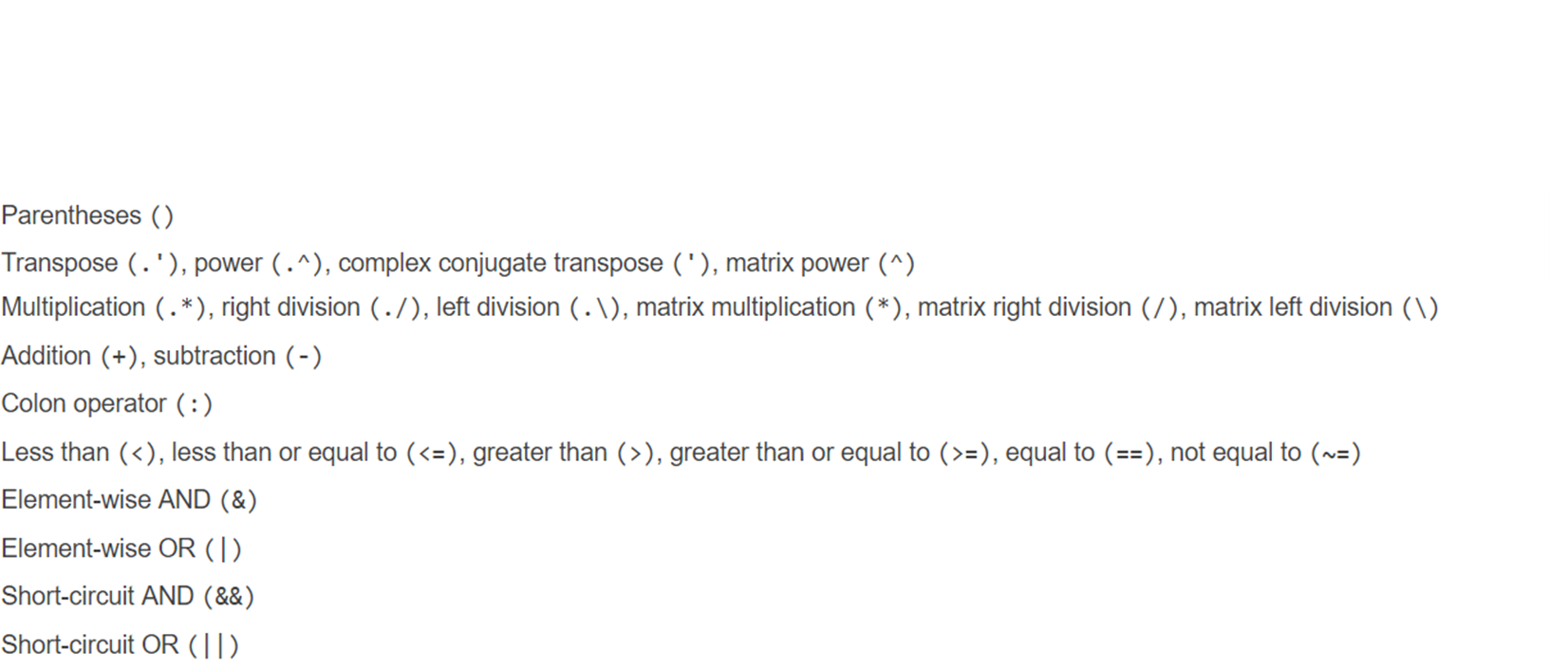
Operator Precedence
https://www.mathworks.com/help/matlab/matlab_prog/operator-precedence.html

Slide 22
Output
There are two basic output functions:
disp, which is a quick way to display things
fprintf, which allows formatting
The fprintf function uses format specifiers which include place holders; these have conversion characters:
%d integers
%f floats (real numbers)
%c single characters
%s string of characters
Use %#x where # is an integer and x is the conversion character to specify the field width of #
%#.#x specifies a field width and the number of decimal places
%.#x specifies just the number of decimal places (or characters in a string); the field width will be expanded as necessary

Slide 23
Formatting Output
Other formatting:
\n newline character
\t tab character
left justify with ‘-’ e.g. %-5d
to print one slash: \\
to print one single quote: ‘‘ (two single quotes)
Printing vectors and matrices: usually easier with disp

Slide 24
Common Pitfalls
Confusing the format of an assignment statement (make sure that the variable name is always on the left)
Forgetting to use parentheses to pass an argument to a function (e.g., typing “fix 2.3” instead of “fix(2.3)”)
Confusing || and xor
Using = instead of == for equality
Using an expression such as “5 < x < 10” – which will always be true, regardless of the value of the variable x (because the expression is evaluated from left to right; 5 < x is either true (1) or false (0); both 1 and 0 are less than 10)

Slide 25
Programming Style Guidelines
Use mnemonic variable names (names that make sense; for example, radius instead of xyz)
Although variables named result and RESULT are different, avoid this as it would be confusing. (recommendation: do not use capital letters in your variable names)
Do not use names of built-in functions as variable names
Store results in named variables (rather than using ans) if they are to be used later

Slide 26
Slide Credits and References
Stormy Attaway, 2018, Matlab: A Practical Introduction to Programming and Problem Solving, 5th edition
Lecture slides for “Matlab: A Practical Introduction to Programming and Problem Solving”
Holly Moore, 2018, MATLAB for Engineers, 5th edition

